Slide 1
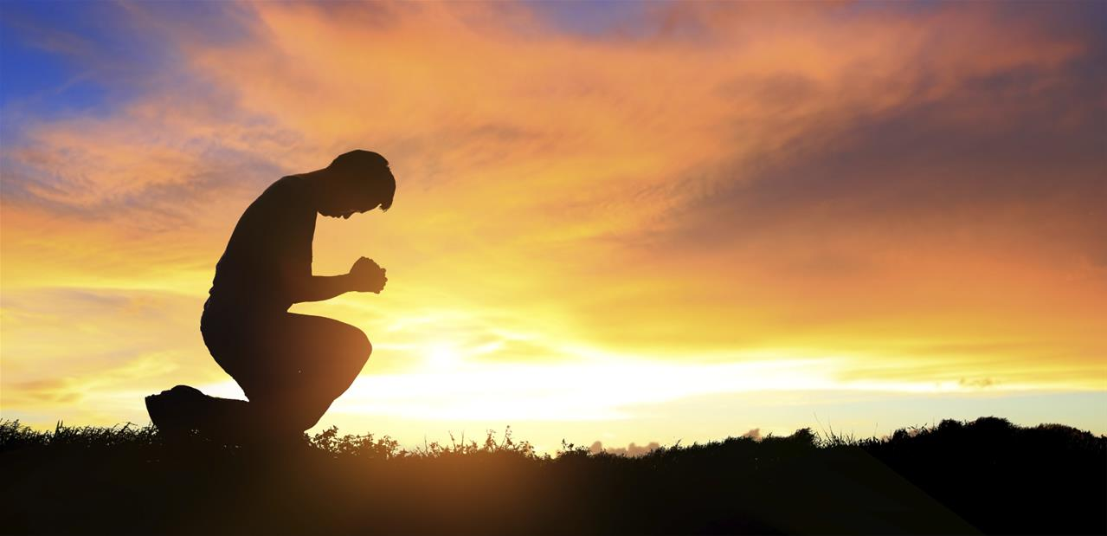
Be Secure
2 Chronicles
Dr. Rick Griffith • Crossroads International Church Singapore
CICFamily.com • BibleStudyDownloads.org

Slide 2
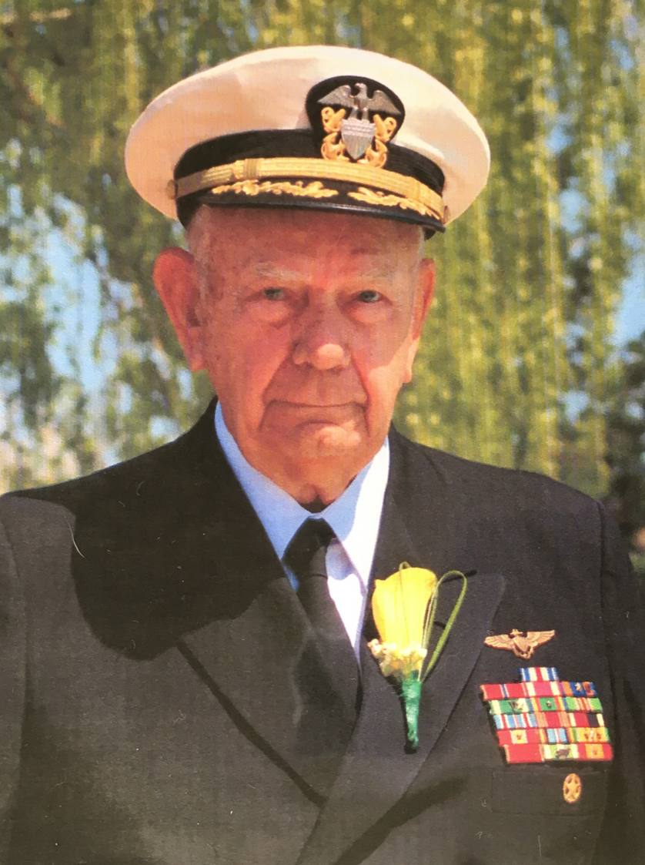
Harold "Hal" Francis Griffith
27 Dec 1925 -29 Jan 2018
Notes:
I want to thank you all for your understanding and grace towards me the past three weeks when I was suddenly gone to care for my dying father. We all need security, and it was great to feel secure that I could leave so suddenly.

Slide 3
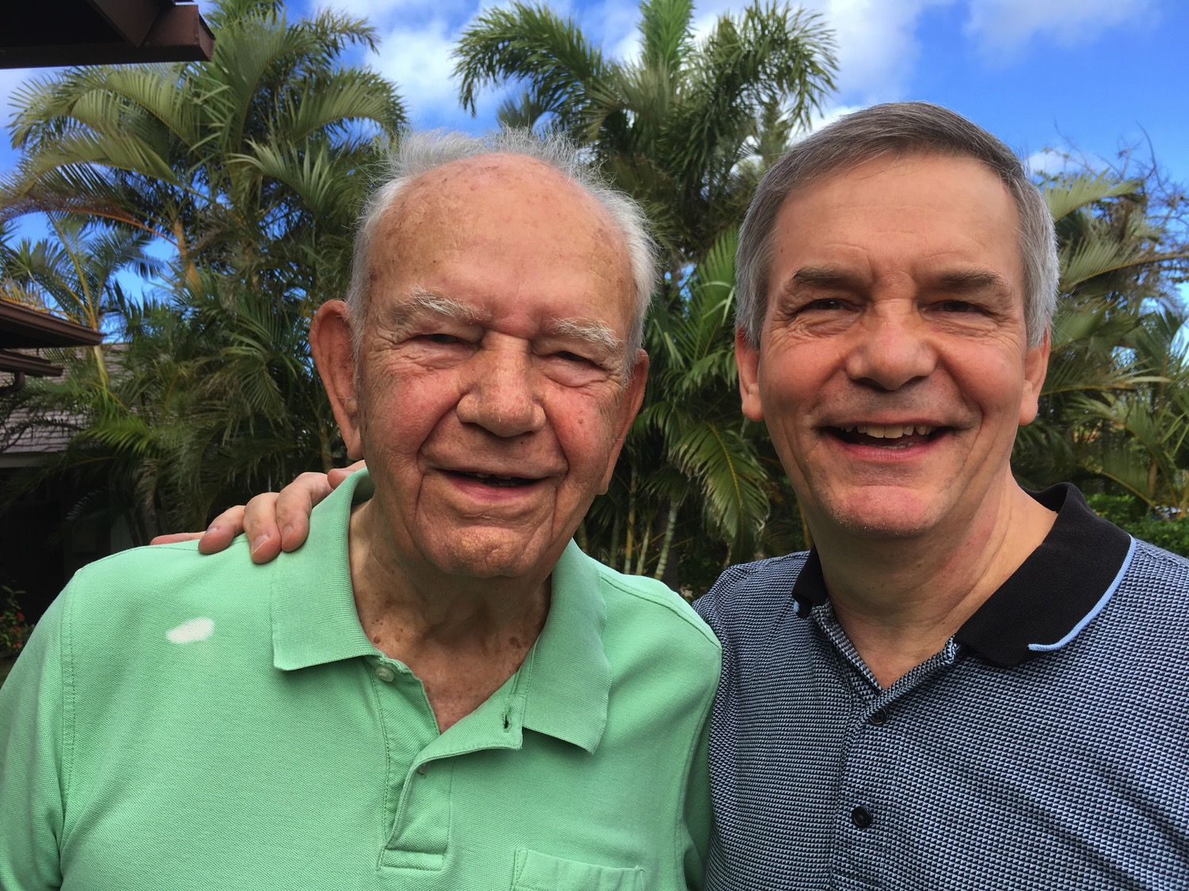
Title
Notes:
Dad takes after me, doesn't he? I've told Susan she can feel very secure in my future. She doesn't have to wonder what I will look like in 30 years!

Slide 4
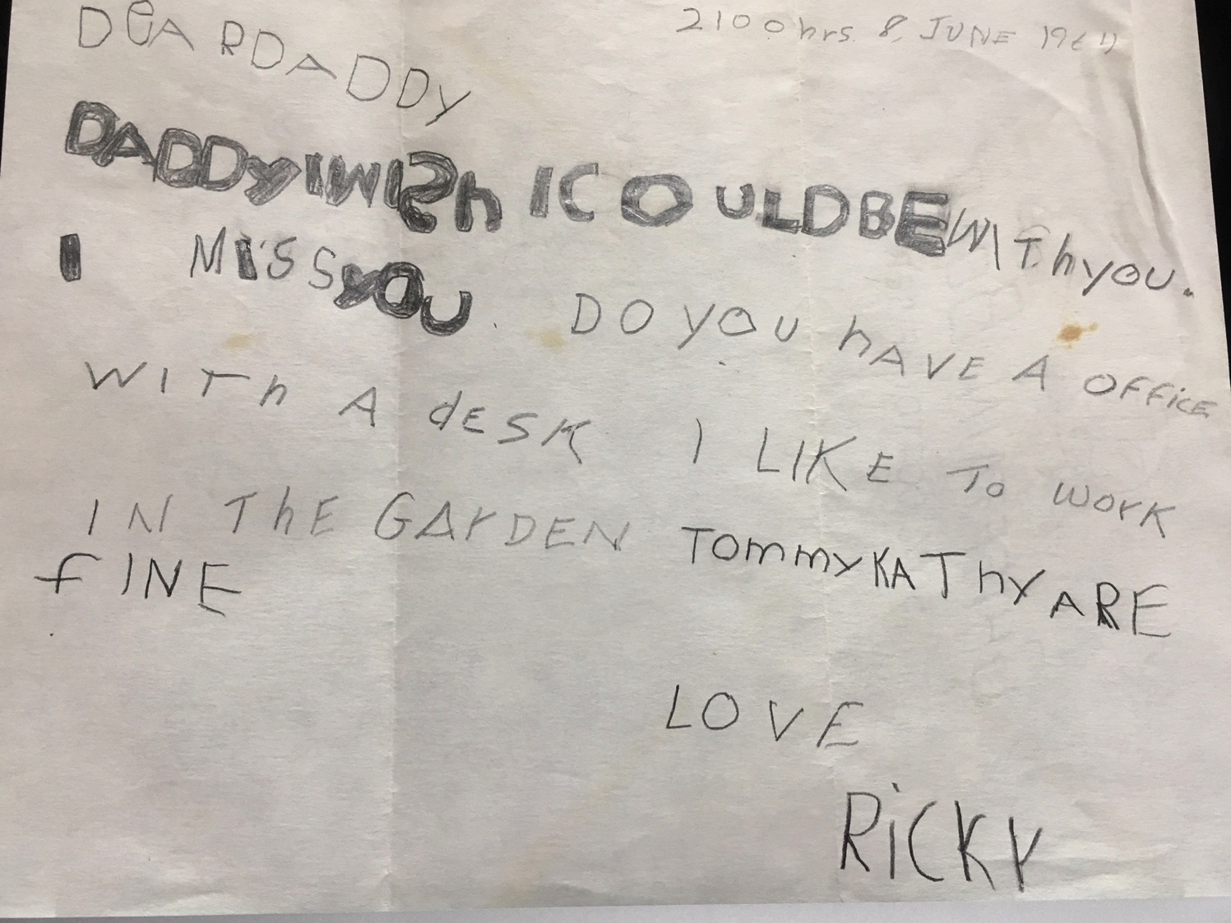
My First Letter
Notes:
Before he died, my father gave me every letter I ever wrote to him—60 of them! I haven't read them all yet, but the oldest I have found is this one when I was 6 years old. It reads…
I wrote this letter two months before my father led the first air strike on North Vietnam! I felt a great sense of insecurity as a boy—knowing my father loved me but was away fighting at war. This made me feel that althrough God loved me, he also was far away doing important things.

Slide 5
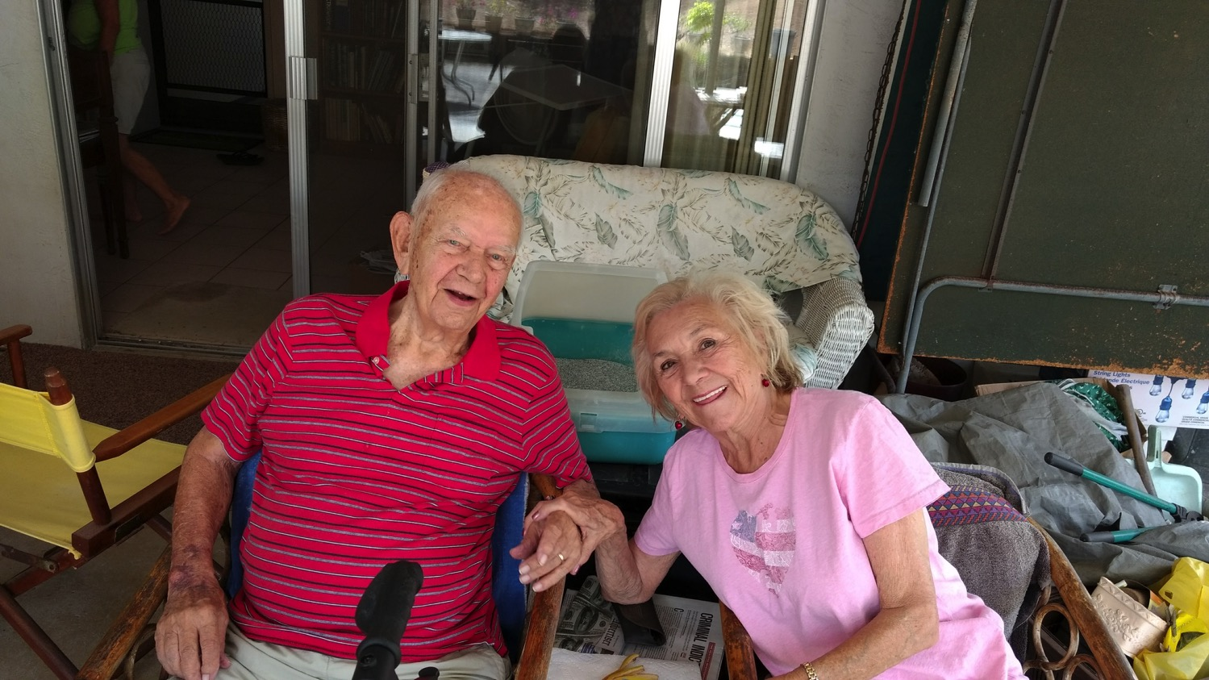
Dad & Mom
Notes:
My insecurity started very young. Some of you know that my parents divorced when I was only 4 years old. But they have remained friends and my mother visited my father just three months before he died.

Slide 6
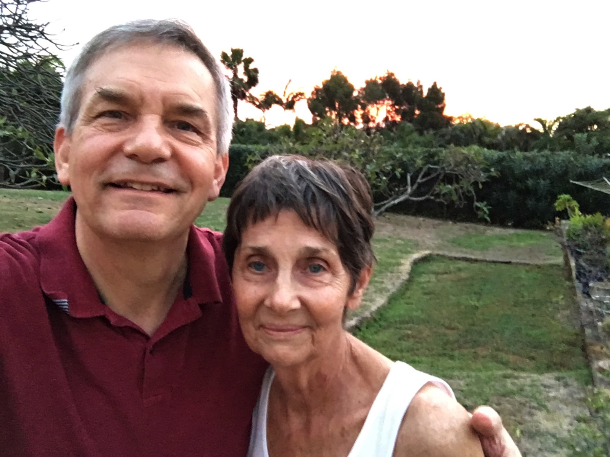
Taking Care of Carolynn
Notes:
So most of my time the past three weeks was caring for my step-mom, Carolynn. She has felt very insecure what will happen to her now—the house, the finances, the future…

Slide 7
Early Years
Notes:
My Dad's own insecurities also started very young.

Slide 8
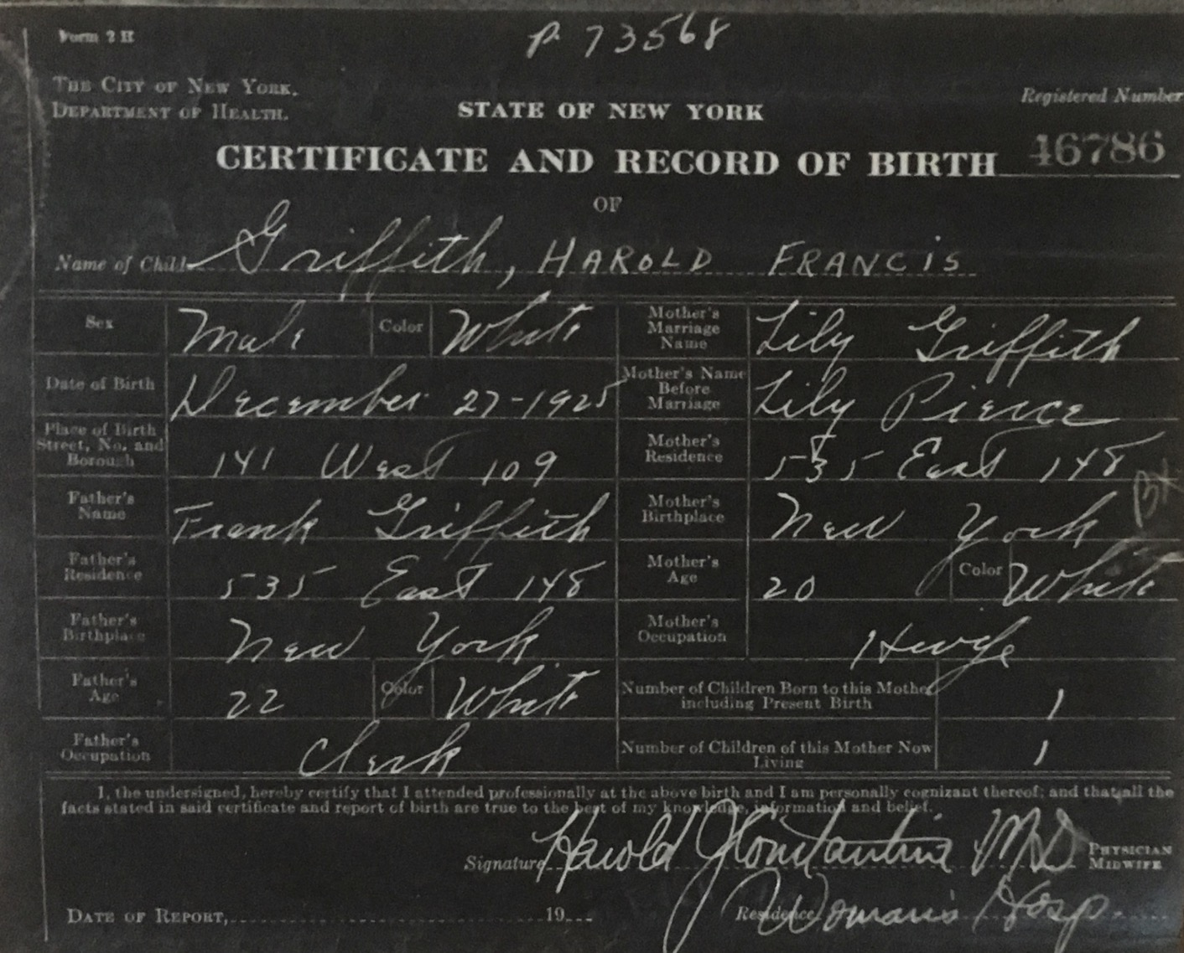
Title
Notes:
Dad felt like he needed security—for his start in life was something few of us could imagine. I saw his birth certificate for the first time this month. It is hand-written in cursive, and under “name,” all it reads is, “Griffith.” No first name. No middle name. Just “Griffith.” But next to it is written in ALL CAPS the words “Harold Francis.” For his first 17 years he was known as “Harry Frank.” Harry was his grandpa and Frank was his father.

Slide 9
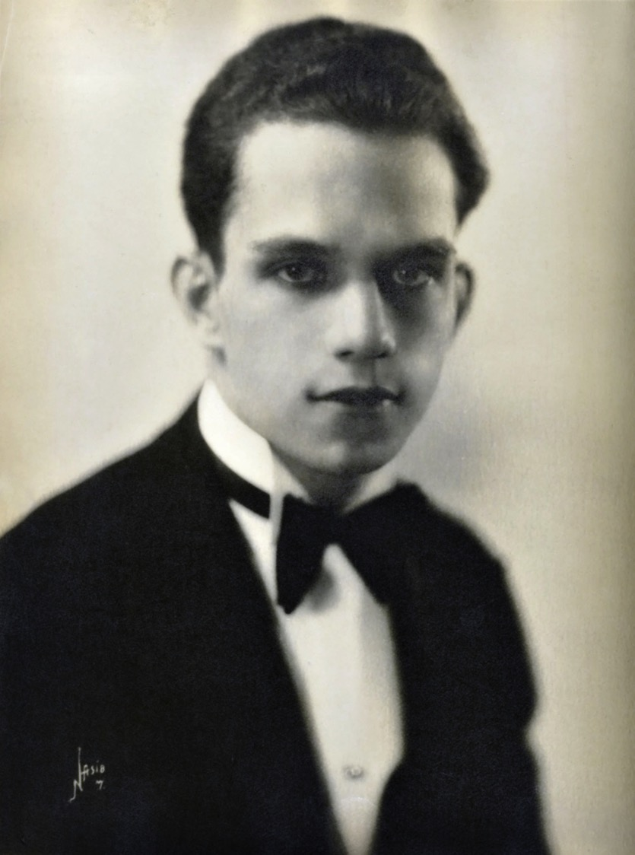
Title
Notes:
Frank was his father.

Slide 10
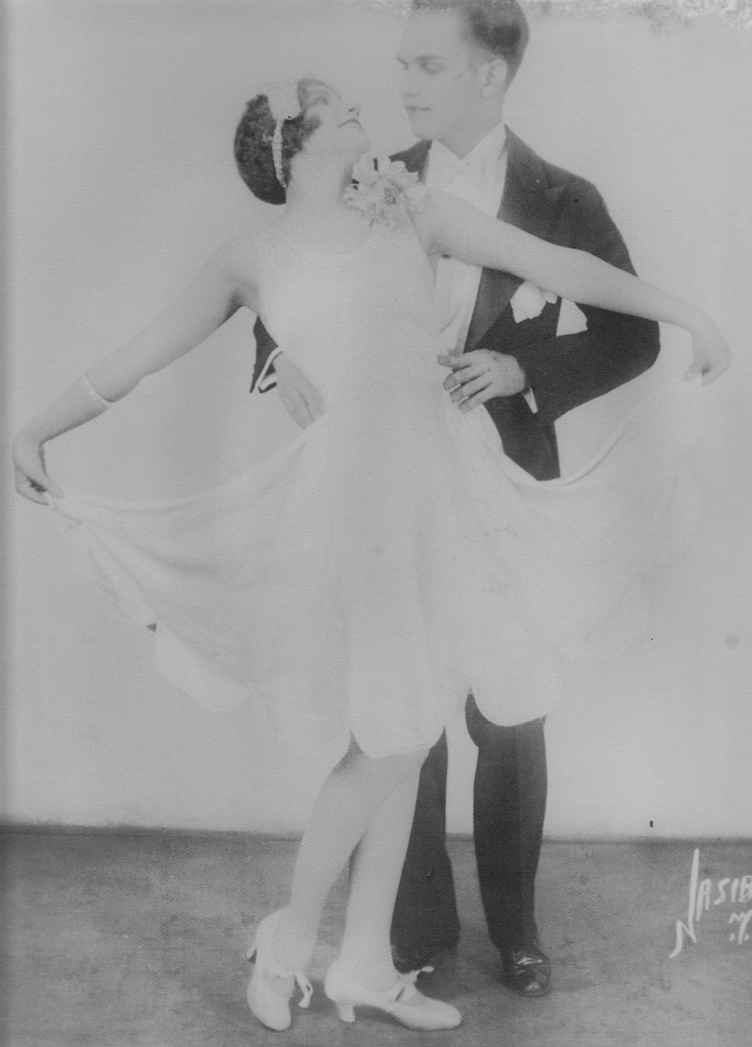
Title
Notes:
Yet both of his parents—famous dancers in the mid 20s, believe it or not—dropped him off at his maternal grandparents home as a baby and they went on tour to the Caribbean.

Slide 11
Title
Notes:
So, at age 17, upon entering the Navy, he had to look up his birth certificate. There he found no first or middle name! So he had the unusual privilege—if you call it that—to name himself. He decided to keep the same H.F. initials, choosing Harold Francis.

Slide 12
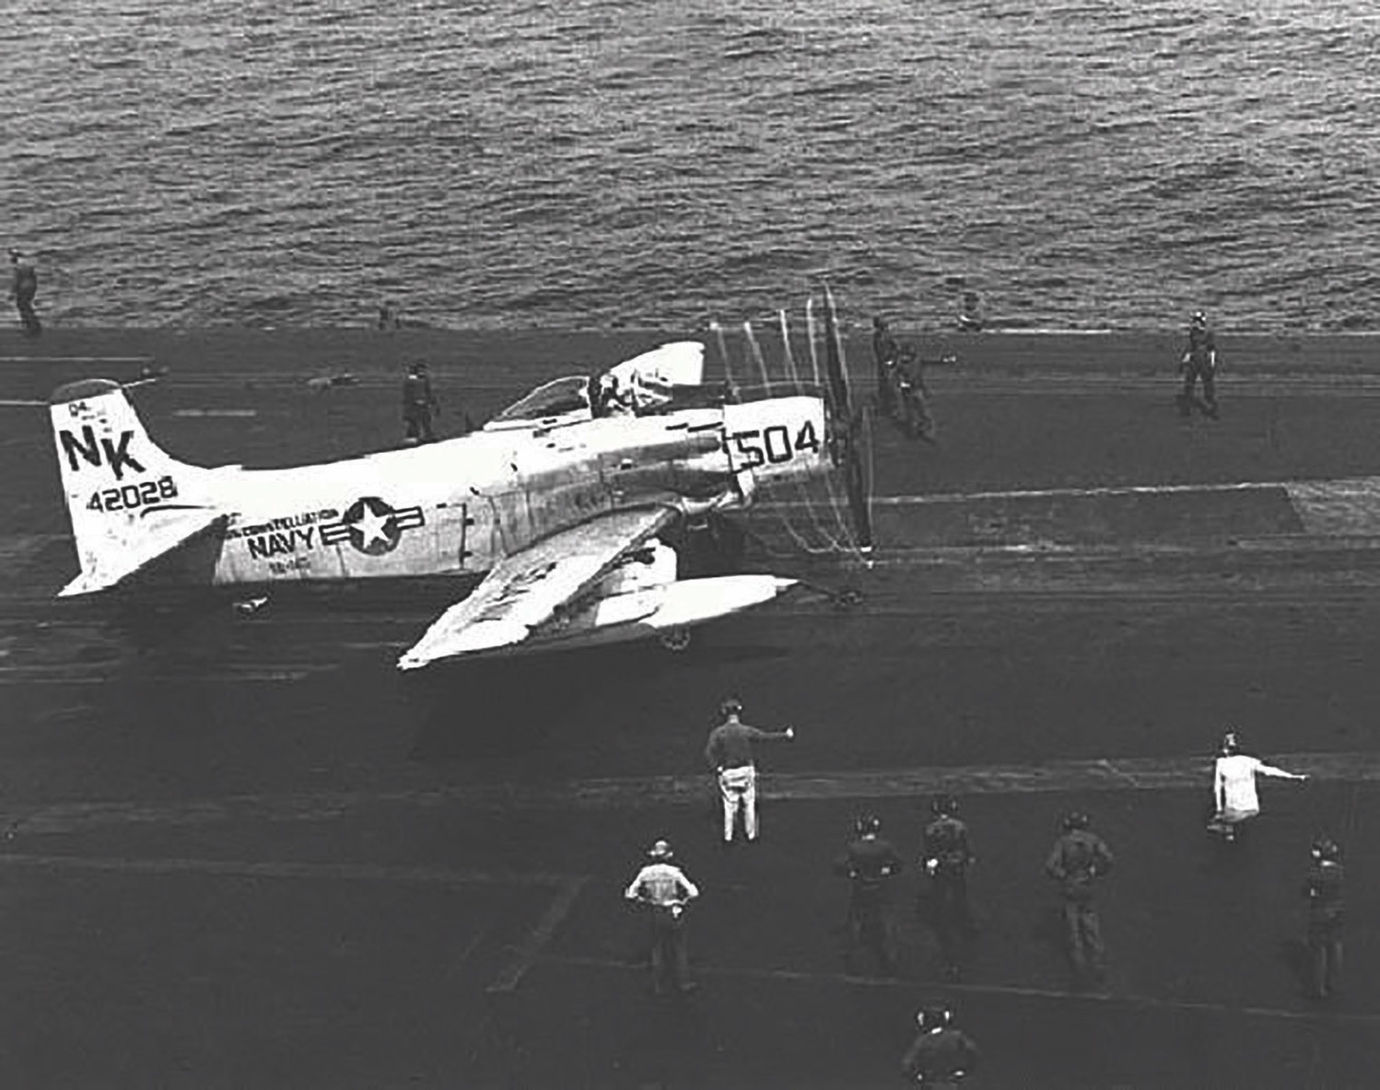
Title
Notes:
Dad flew the A-1 Skyraider that had the most powerful engine ever on a propeller fighter—so strong that when taking off from a carrier that the pilot had to immediately jerk the plane to the right or else the power of the propeller would flip the plane upside down into the sea. He had an amazing 660 carrier landings!

Slide 13
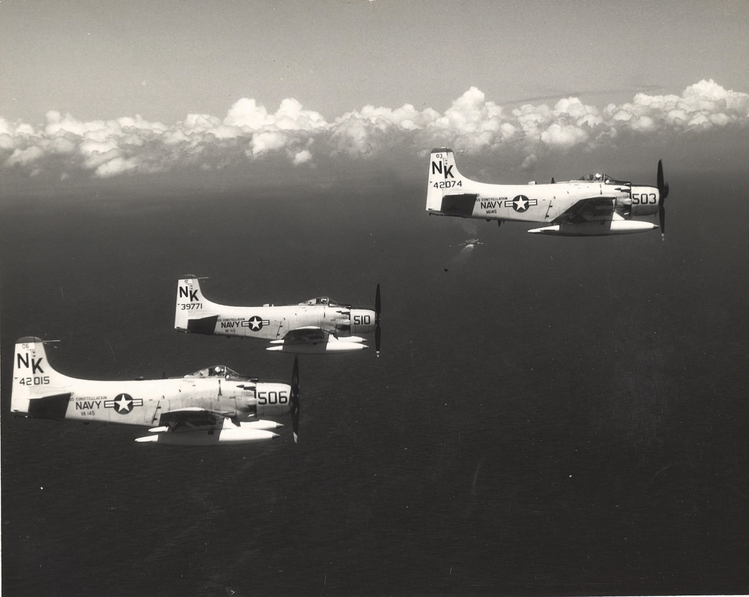
Title
Notes:
He also flew and incredible 186 combat missions destroying supply bridges and boats in a barrage of anti-aircraft fire. This plane flew very low in the face of enemy fire—not much security there!

Slide 14
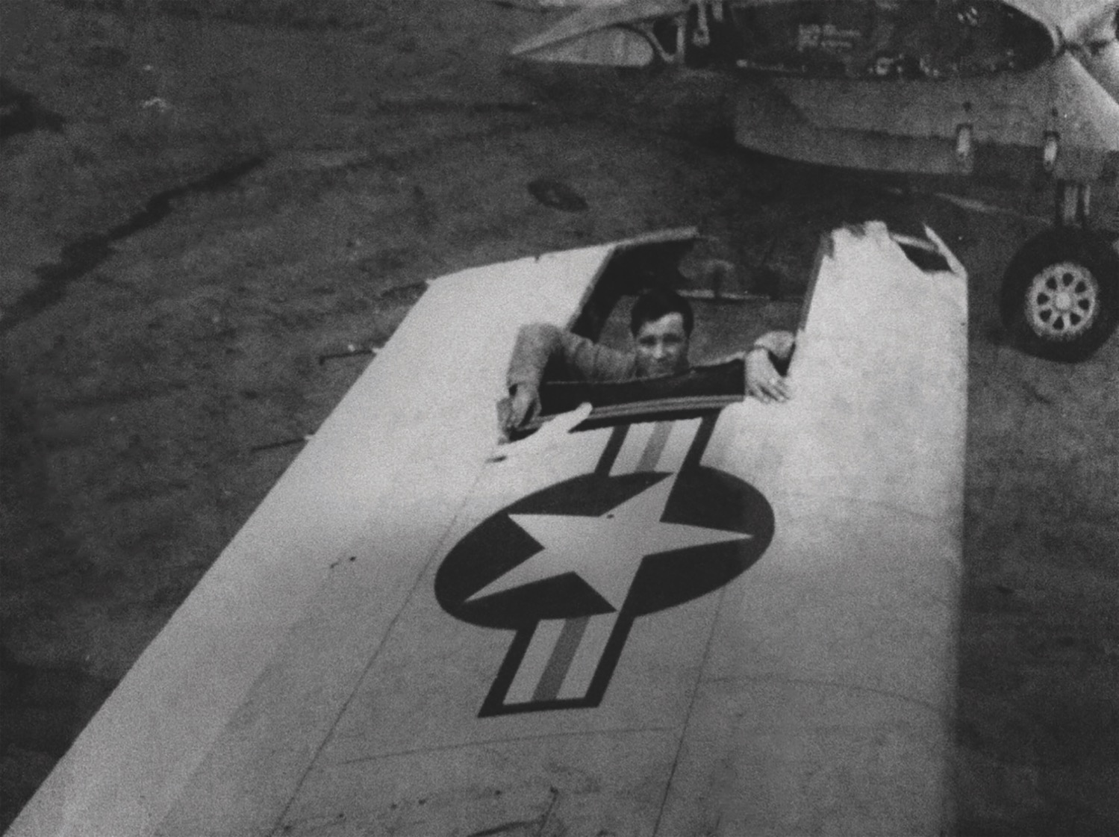
Title
Notes:
Once the left wing of his plane was so shot up that he could only steer right and not make it back to the carrier to land so he flew to a friendly airbase instead. He looped and looped to eventually land safely.

Slide 15
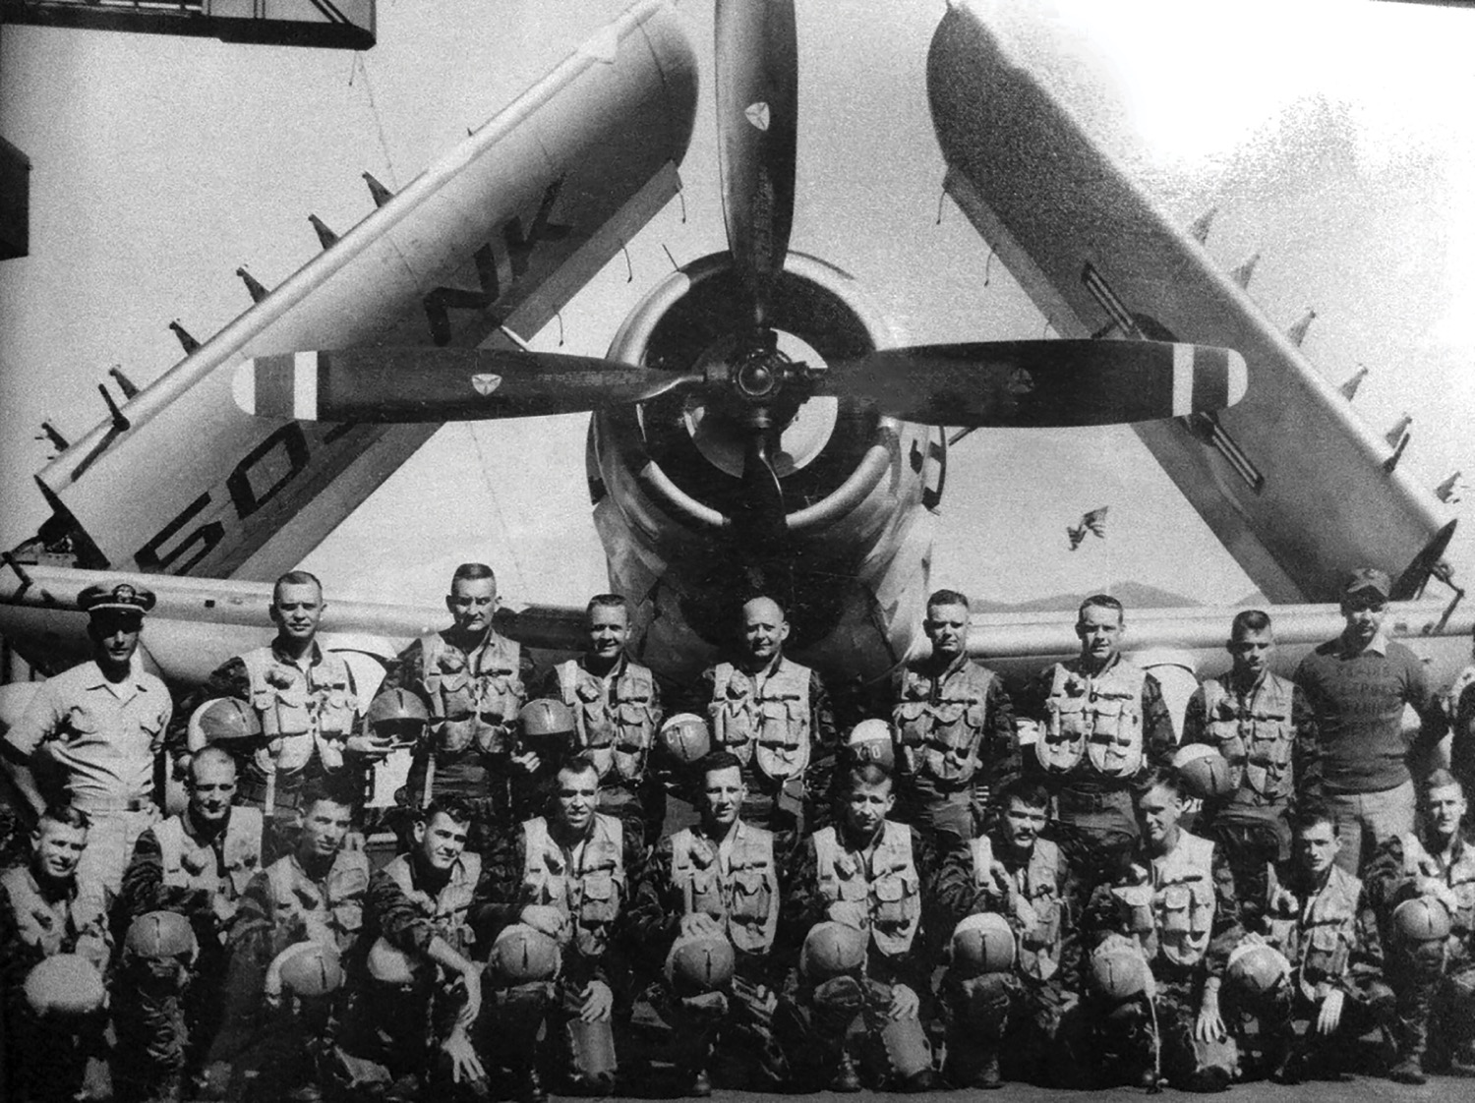
Title
Notes:
I asked him how he could see over 50 of his fellow pilots die but he was spared. He didn’t attribute this to his astonishing flying ability—though he was one of the best pilots in the Navy. He clearly noted that God himself watched over him “in the presence of mine enemies.” He was learning about security in war.

Slide 16
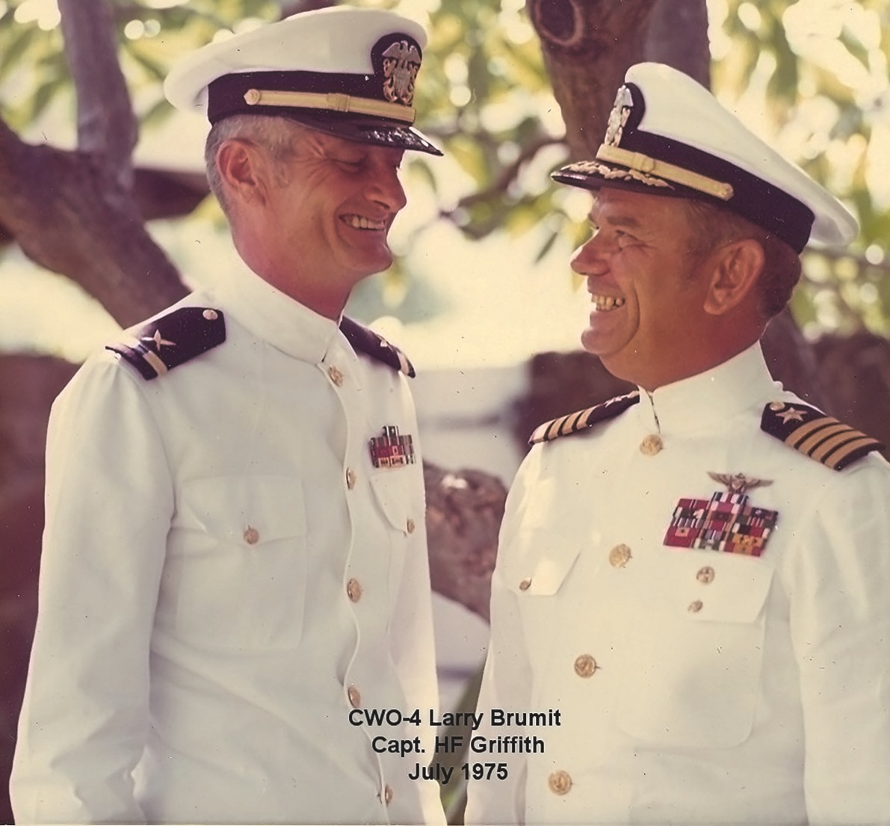
Captain (1968)
Notes:
Amazingly, he was promoted to Captain 50 years ago!

Slide 17
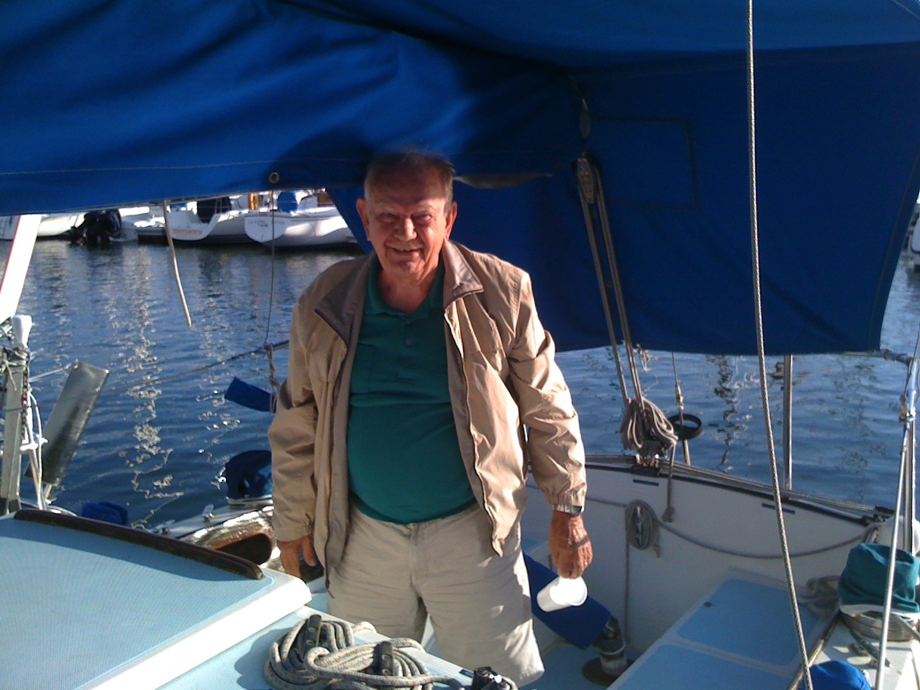
Title
Notes:
My Dad was an avid sailor the 33 years of retirement that he had from age 59-92.

Slide 18
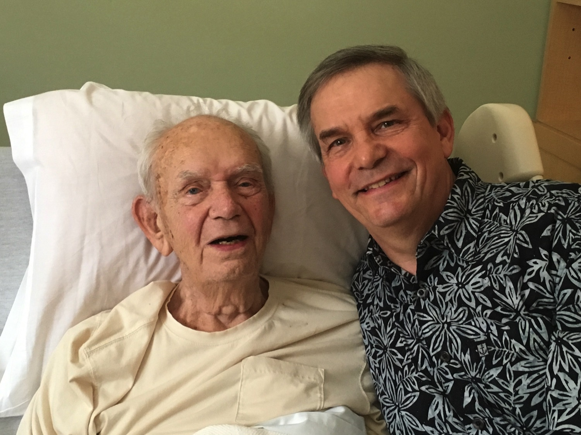
Title
Notes:
And I was privileged to help him place his security in Jesus during his last days on earth. He assured me time and again that he was trusting Christ.

Slide 19
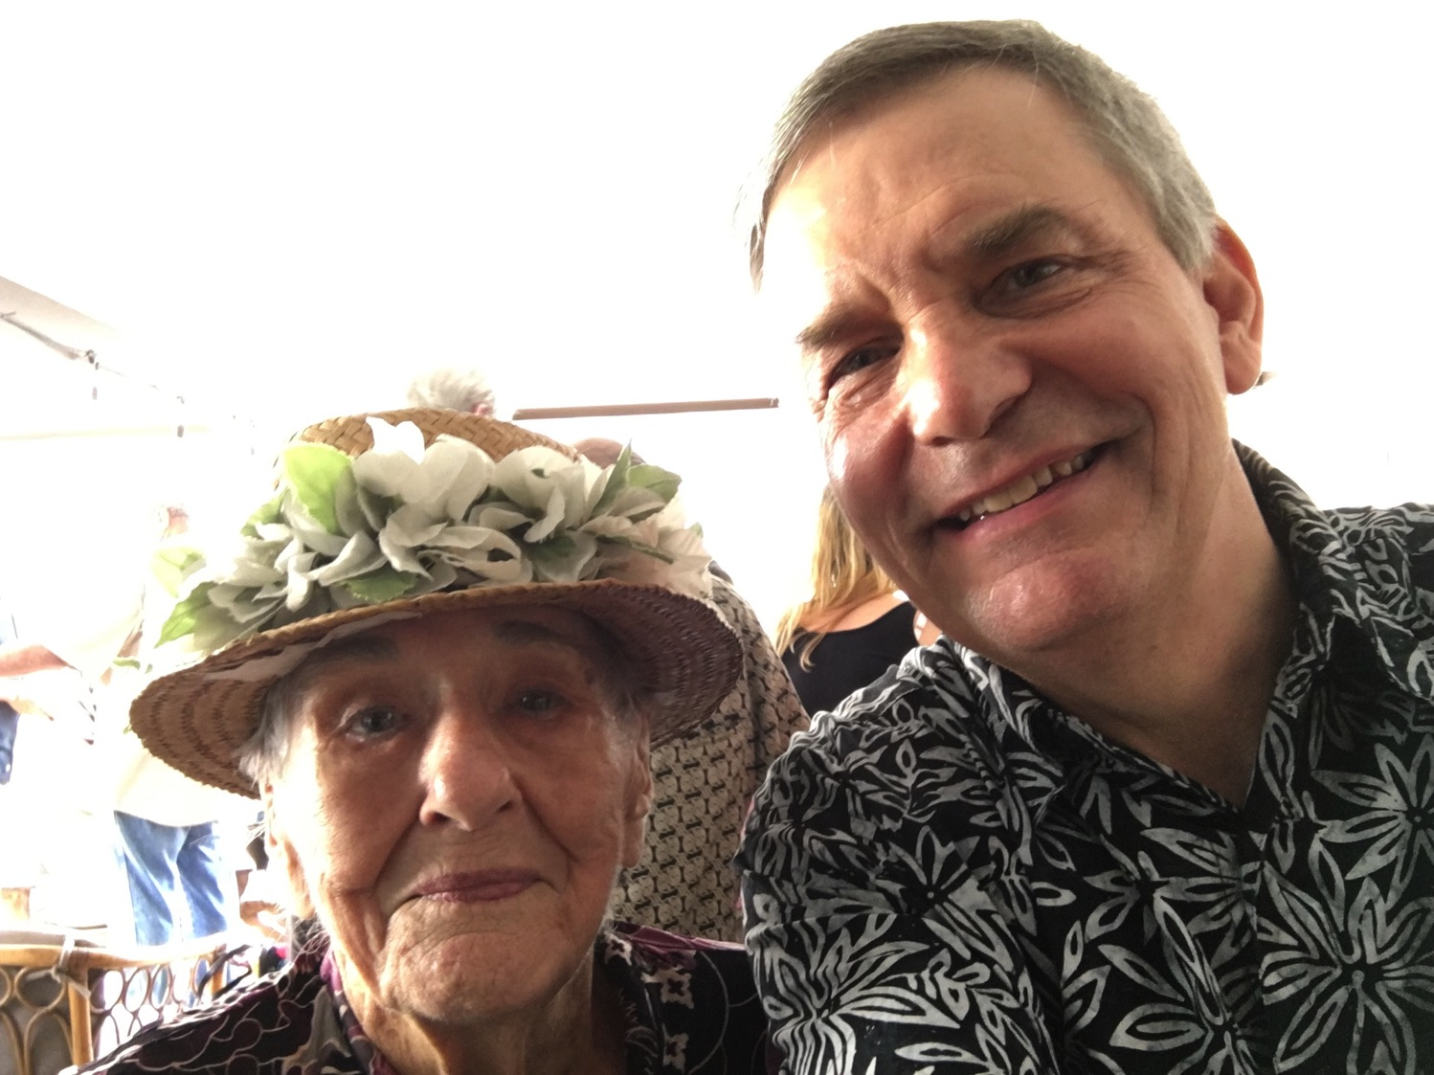
Marie
Notes:
And at Dad's bed just hours before he died I had the privilege of leading his 94-year-old mother-in-law to faith in Christ.

Slide 20
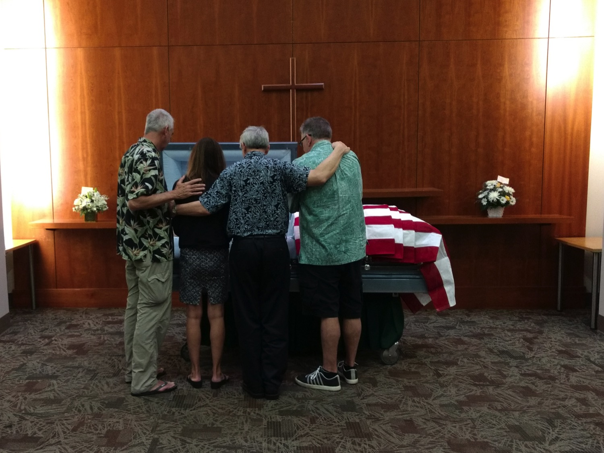
Siblings
Notes:
It was also a great time of bonding with my two brothers and sister when I spoke at his memorial service.

Slide 21
security sɪˈkjʊərɪti,sɪˈkjɔːrɪti/
Noun
1. the state of being free from danger or threat.
"the system is designed to provide maximum security against toxic spills"
synonyms: certainty, safe future, assured future, safety, reliability, dependability, solidness, soundness "employees have an interest in the security of their jobs"
Notes:
Maybe you have caught on the theme of what I have been saying. It is our need for security.

Slide 22
God made us to feel secure in our walk with him.
Yet too often we are anything but secure.
Notes:
How much do you worry about the future?
What do you think God thinks about you?

Slide 23
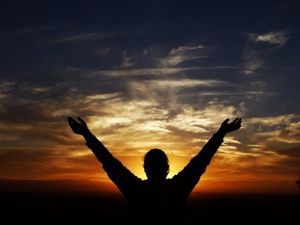
How does God help us be secure?
Notes:
How does the LORD guide us towards this sense of well-being that we all need?

Slide 24
Blessings & Curses
154
220
Deut. 28
Your towns and your fields
will be blessed (3)
Your towns and your fields
will be cursed (16)
Your children and your crops
will be blessed (4)
Your children and your crops
will be cursed (17)
Your fruit baskets and bread-boards will be blessed (5)
Your fruit baskets and bread-boards will be cursed (18)
Wherever you go and whatever you do, you will be blessed (6)
Wherever you go and whatever you do, you will be cursed (19)
Your enemies will attack you from one direction, but they will scatter from you in seven! (7)
You will attack your enemies from one direction, but you will scatter from them in seven! (25)
You will lend to many nations, but you will never need to borrow from them (12)
They will lend to money to you, but you will not lend to them
(44)

Slide 25
Prophetic Curses
154
220
Why?
Exile
Deut. 28
Notes:
Jeremiah's prophecy and Lamentations record his eyewitness account of Babylon's siege and destruction of Jerusalem for the nation's sin, the Holy Spirit moved him to record an historical compilation which provides the context and justification for God's judgment upon these two nations. The leaders and the people sinned through ungodliness and idolatry, and true to the curses of Deut. 28, God gave the people the consequences of their obedience.

Slide 26
Key Verse
262
"I declare that the LORD will build a house for you: When your days are over and you go to be with your fathers, I will raise up your offspring to succeed you, one of your own sons, and I will establish his kingdom. He is the one who will build a house for me, and I will establish his throne forever. I will be his father, and he will be my son. I will never take my love away from him, as I took it away from your predecessor. I will set him over my house and my kingdom forever; his throne will be established forever" (1 Chron. 17:10b-14).
1 Chronicles

Slide 27

1 Chronicles Book Chart
1 Chronicles
262
David's Line Established
David's Line
David's Concern (Ark / Temple)
Chapters 1–9
Chapters 10–29
Genealogy
History
Ancestry
Activity
Saul's Throne to David
David's Throne to Solomon
4143-1011 BC (3132 years)
1011-971 BC (40 years)
Davidic Line
1–3
Tribal
Lines
4–8
Priests /
Levites
9:1-34
Saul's Line
9:35-44
Accession to Throne
10–12
Respect for Ark
13–17
Military Victories
18–20
Temple Prep.
21–29

Slide 28
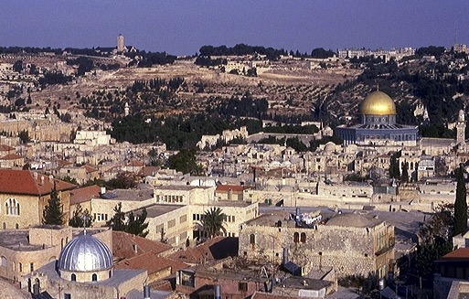
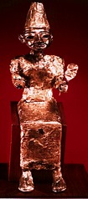


IDOL WORSHIP!
1 Kings 11:4-13
ROYALTY
The Mount of Olives
ca. 1000 B.C.
S - D - S
DC
2 Sam 7: 4-16
1 Chron 17:3-15
A R C
The Temple Mount
ROYALTY
S - D - S
Handbook pg. 32-37
38
4
Notes:
Why? Along with Solomon's many foreign treaties he had also acquired many foreign wives from the country with which he made the treaty. The new wives moved into Jerusalem bringing with them their idolatrous religious practices.
//// On that site of today's Temple Mount…after SOLOMON had completed the first Temple to the God of Israel – and worshiped there - he later could be seen…
//// …over on The Mount of Olives across the Kidron Valley from his newly built temple…
//// worshipping the pagan gods brought into town by those foreign wives.
//// So…once again…idol worship entered the day to day life of ancient Israel, foreshadowing other great national problems to come

Slide 29
The chief reason they had gone into exile was idolatry. How could they really be cured of false worship?
Notes:
What method would God use to convince the people to worship him alone? He chose to write a history—a theological history.

Slide 30
2 Chronicles Synthesis
274
David's line preserved
1–9 Solomon
10–36 Davidic dynasty

Slide 31
How does God help us be secure?
2 ways
Notes:
How does the LORD guide us towards this sense of well-being that we all need?

Slide 32

I. God blesses our worship.
2 Chronicles 1–9
Notes:
The LORD honors us when we honor him—and this gives us a sense of security.

Slide 33
Israel's "First" Temple
1 Kings 5:5
God blessed Solomon for building the temple
(2 Chron 1–9).
ROYALTY
S - D - S
Handbook pg. 32-37
30

Slide 34
2 Chronicles Book Chart
2 Chronicles
271
David's Line Preserved
Solomon
Davidic Dynasty
Chapters 1–9
Chapters 10–36
Temple Constructed
Temple Destroyed
Royalty
Ruins
40 Years
393 Years
971-931 BC
931-538 BC
Wealth & Wisdom
1
Temple Construction
2–7
Successes
& Death
8–9
Kingdom Divides via Rehoboam
10–12
7 Bad,
8 Good Kings
13–35
4 Bad Kings then Judah Falls
36
1 Kings 1–11
1 Kings 12–22
2 Kings 1–25

Slide 35

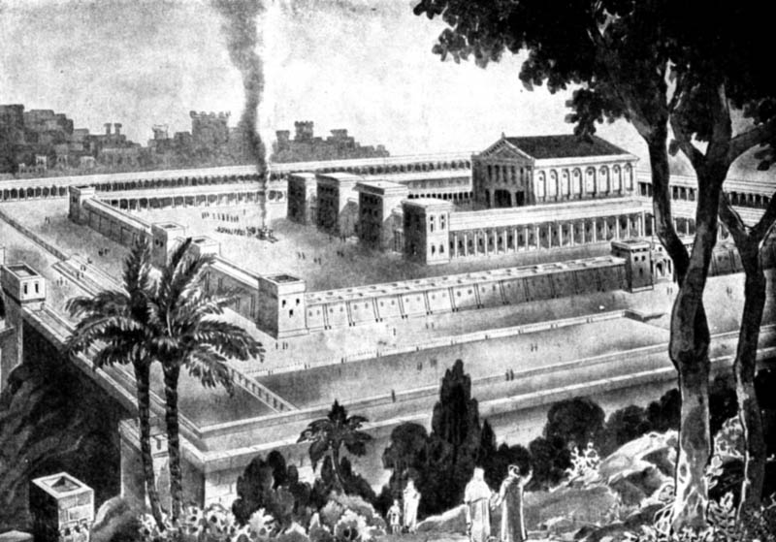
The Temple
Solomon
Notes:
Solomon made the temple and filled it with new furnishings (plus excess gold and silver for the treasuries) in anticipation of the ark’s arrival (3:1–5:1).

Slide 36
Parallels between David's and Solomon's Transfers of the Ark
275
David
(1 Chron.)
Solomon
(2 Chron.)
Ark location before transfer
Kiriath Jearim
City of David
Ark location after transfer
House of Obed near the City of David
Temple on Moriah (former threshing floor of Araunah)
Consultation with Israel's leaders & national procession
13:1-5
5:2-3
Transports the ark correctly
15:1–16:3
5:2-10
Celebration of praise at arrival
16:7-36
5:11-14
System of regular worship set up
16:4-6, 37-42
8:12-16
Divine revelation given
17:1-15
7:12-22
Prayer by the king
17:16-27
6:12-42
Notes:
Solomon made the temple and filled it with new furnishings (plus excess gold and silver for the treasuries) in anticipation of the ark’s arrival (3:1–5:1).

Slide 37
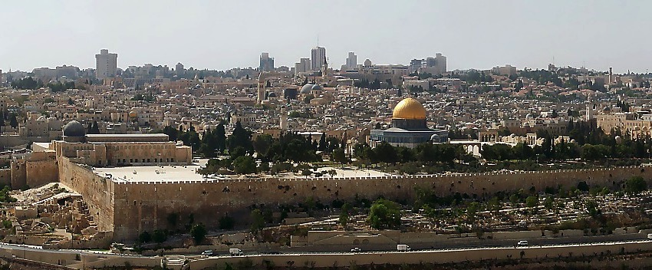

THE ENORMOUS IMPORTANCE OF THE TEMPLE MOUNT!
1 Kings 6:14-38; Matt 21:12-17
• Spiritual
• Theological
• Political
• Geographical
ROYALTY
S - D - S
• Eschatological
Handbook pg. 32-37
34
6
Notes:
So now…every time you see news footage of Jerusalem, reports of its internal conflicts between Jews and Arabs…just remember the enormous importance of the Temple Mount…the center of it all…
//// The First Temple of King David, the Second Temple built for the Jews by Zerubbabel and expanded by King Herod the Great. Finally, today, the Moslem Dome of the Rock and Al Aqsa Mosque stand on this site. This small acreage was…
//// Israel's SPIRITUAL center and ritual focus…
//// its THEOLOGICAL and ritual cornerstone…
//// the POLITICAL center of the Jewish universe…
//// the GEOGRAPHICAL center of the Abraham's inheritance…and
//// for all believers, a key to our understanding of the events of the End Times…that being, the study of Biblical ESCHATOLOGY.

Slide 38

The Temple Mount in Today's Jerusalem:
A Prime Focal Point of Planet Earth
1 Kings 6:14-38; Matt 21:12-17
Handbook pg. 32-37
35
Notes:
Now we can pull back and view the entire Jerusalem panorama with much greater appreciation of all that has happened there. The Temple Mount of today's Jerusalem continues as the tightly focused center of world concern as the sons of Sarah and the sons of Hagar continue their ancient dispute in the land where it all began!

Slide 39
God honors us...
Solomon teaches us in
1 Chronicles 1–9.
...when we honor him.
Notes:
This is the lesson Solomon teaches us in 1 Chronicles 1–9.

Slide 40
Humility & Repentence
271
"Then if my people who are called by my name will humble themselves and pray and seek my face and turn from their wicked ways, I will hear from heaven and will forgive their sins and restore their land"
(2 Chronicles 7:14 NLT).

Slide 41
Key Verse
271
"As for you [Solomon], if you walk before me as David your father did, and do all that I command, and observe my decrees and laws, I will establish your royal throne, as I covenanted with David your father when I said, 'You shall never fail to have a man to rule over Israel'"
(2 Chronicles 7:17-18).

Slide 42

KEY VERSE
162
Key Verse of Joshua
"Do not let this book of Law
depart from your mouth;
meditate upon it
day and night, so that you
may be careful to do
everything written
in it. Then you will be
prosperous and successful"
——Joshua 1:8——
Notes:
The way they were to serve the LORD was first to base their lives on what Moses had already written.

Slide 43
How does God help us be secure?
2 ways
Notes:
How does the LORD guide us towards this sense of well-being that we all need?

Slide 44
I. God blesses our worship.
2 Chronicles 1–9
Notes:
The LORD honors us when we honor him—and this gives us a sense of security.

Slide 45

II. God preserves us even in discipline.
2 Chronicles 10–36
Notes:
The LORD gives us security by keeping our salvation even when we’re unfaithful.

Slide 46
Slides on
2 Chronicles 10
Notes:
God judged Jerusalem’s kings for despising the temple but still preserved them (2 Chron 10–36).

Slide 47
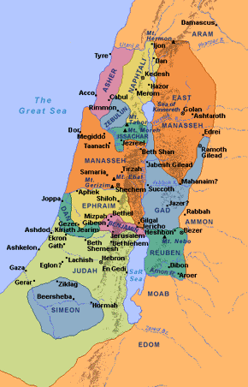
United Kingdom
Israel

Slide 48
Divided Kingdom
Israel
Judah

Slide 49
Decline of Israel
278
JEROBOAM
AHAB
HOSHEA
Huang Sabin, Singapore Bible College
Notes:
Israel had a steady decline from Jeroboam to Ahab to Hoshea.

Slide 50
Decline of Judah
278
ASA
HEZEKIAH
REHOBOAM
JOSIAH
ATHALIAH
MANASSEH
ZEDEKIAH
Huang Sabin, Singapore Bible College
Notes:
Judah had some times when they worshipped right, so they lasted longer with some upswings.

Slide 51
Key Word
271
Preservation
Notes:
God judged Jerusalem’s kings for despising the temple but still preserved them (2 Chron 13–36).

Slide 52
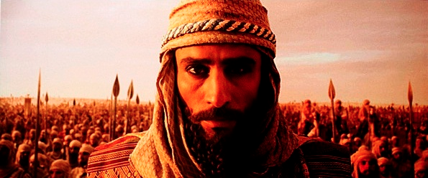
The kings fell into four basic types.

Slide 53
Patterns of Kingly Rule
279
Good with a Bad End (8)
Solomon* (1:1), Asa (14:2), Jehoshaphat (17:3; 20:37), Joash (24:22), Amaziah (25:19, 27), Uzziah (26:16), Hezekiah (32:25), Josiah (34:1–36:1)
Bad with a Good End (3)
Rehoboam (12:6-7, 12), Abijah** (=Abijam; 13:10; 1 Kings 15:3), Manasseh (33:12, 19)
Good to Better (2)
David (1 Kings 3:6),
Jotham (27:6)
Bad to Worse (9)
Jehoram (21:6, 11-12), Ahaziah (20:35; 22:3), Athaliah (22:10), Ahaz (28:22), Amon (33:20-25), Jehoahaz (36:1; cf. 2 Kings 13:2), Jehoiakim (36:5), Jehoiachin (36:9), Zedekiah (36:12)
Adapted from Huang Sabin, Singapore Bible College
Notes:
Bible teacher Huang Sabin insightfully notes that the kings fell into four general groups. None of them actually maintained the same type of rule, as each got either better or worse in four patterns of kingly rule.

Slide 54
Patterns of Kingly Rule
279
Good with a Bad End (8)
Solomon* (1:1), Asa (14:2), Jehoshaphat (17:3; 20:37), Joash (24:22), Amaziah (25:19, 27), Uzziah (26:16), Hezekiah (32:25), Josiah (34:1–36:1)
Adapted from Huang Sabin, Singapore Bible College

Slide 55
Patterns of Kingly Rule
279
Bad with a Good End (3)
Rehoboam (12:6-7, 12), Abijah** (=Abijam; 13:10; 1 Kings 15:3), Manasseh (33:12, 19)
Adapted from Huang Sabin, Singapore Bible College

Slide 56
Patterns of Kingly Rule
279
Good to Better (2)
David (1 Kings 3:6),
Jotham (27:6)
Adapted from Huang Sabin, Singapore Bible College

Slide 57
Patterns of Kingly Rule
279
Bad to Worse (9)
Jehoram (21:6, 11-12), Ahaziah (20:35; 22:3), Athaliah (22:10), Ahaz (28:22), Amon (33:20-25), Jehoahaz (36:1; cf. 2 Kings 13:2), Jehoiakim (36:5), Jehoiachin (36:9), Zedekiah (36:12)
Adapted from Huang Sabin, Singapore Bible College

Slide 58
Slides on
2 Chronicles 21

Slide 59
God ultimately defeats those who worship idols.
2 Chron. 21–22

Slide 60
Family Wickedness (2 Chron. 21–22)
238
Ethbaal
King of Sidonians
Omri
King of Israel
Asa
King of Judah
(Line of David)
Jezebel
Ahab
Jehoshaphat
Ahaziah
Jehoram (Joram)
Athaliah
Jehoram
All brothers killed
(2 Ch 21:4)
All brothers killed
(2 Ch 22:1)
Killed by Jehu
Ahaziah
All brothers killed
(2 Ch 22:11)
Joash
Good kings in white; queen in gray italics
Notes:
It may sound confusing, but there were two kings who lived at the same time in the northern and southern kingdoms who were named Jehoram and two named also Ahaziah—Ahaziah of Israel on the left and Ahaziah of Judah on the right. In 2 Kings 11:2 (cf. 2 Chron. 22:11), we read how the Davidic line was all wiped out by the mother of Ahaziah of Judah—all except one of her grandsons named Joash. God's promise of an eternal king through David (2 Sam. 7:14) would have been unfulfilled had it not been through the courage of Jehoshebah, Ahaziah's sister, who saved the life of the infant nephew, Joash. In fact, the line dwindled to only one living descendant of David the preceding two generations also!

Slide 61
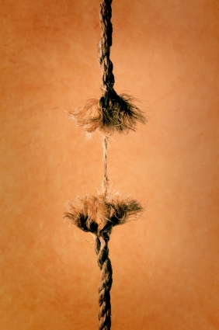
Faithful By A Thread
The Davidic rulers came down to only one man (three times!)

Slide 62
Slides on
2 Chronicles 22

Slide 63
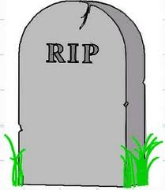
Family Righteousness (22:10-12)
238
Aaron
Priest of Israel
Asa
King of Judah
(Line of David)
Jehoshaphat
Athaliah
Jehoram
Ahaziah
Unnamed Nurse
Jehoiada
Jehoshebah
Joash
Righteous in white; queen in gray italics
Notes:
In 2 Kings 11:2 (cf. 2 Chron. 22:11), we read how the Davidic line was all wiped out by the mother of Ahaziah of Judah—all except one of her grandsons named Joash. God's promise of an eternal king through David (2 Sam. 7:14) would have been unfulfilled had it not been through the courage of Jehoshebah, Ahaziah's sister and husband of Jehoiada the priest. Jehoshebah saved the life of her infant nephew, Joash, with the courageous help of his unnamed nurse who raised him for 6 years in the temple out of the murderous eye of Athaliah.

Slide 64
Slides on
2 Chronicles 23

Slide 65
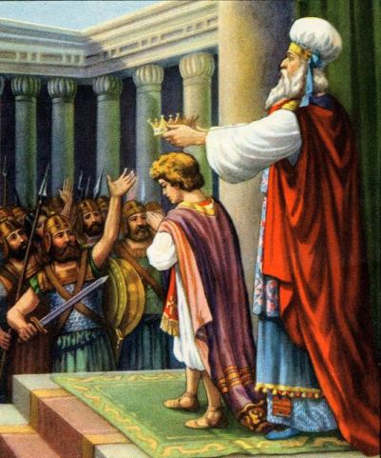
Jehoiada Crowns Joash
(2 Kings 11:12;
2 Chron. 23:11)

Slide 66
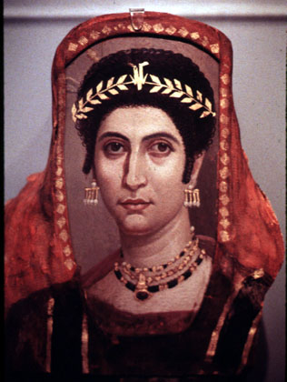
Athaliah Killed
(2 Kings 11:15-16;
2 Chron. 23:14-15)

Slide 67
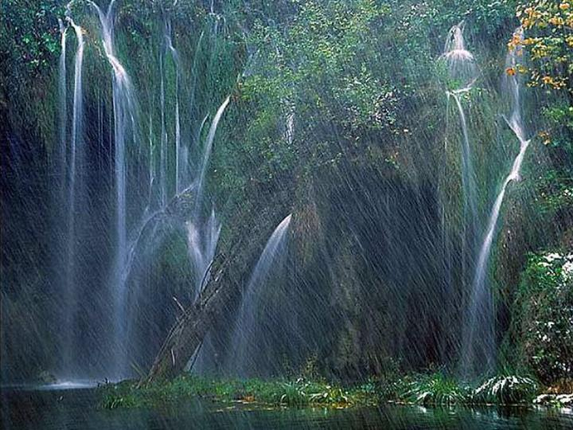
God still keeps His promises to those who worship Him today

Slide 68
God disciplines us but never rejects us.

Slide 69

Eternal Security
61

Slide 70
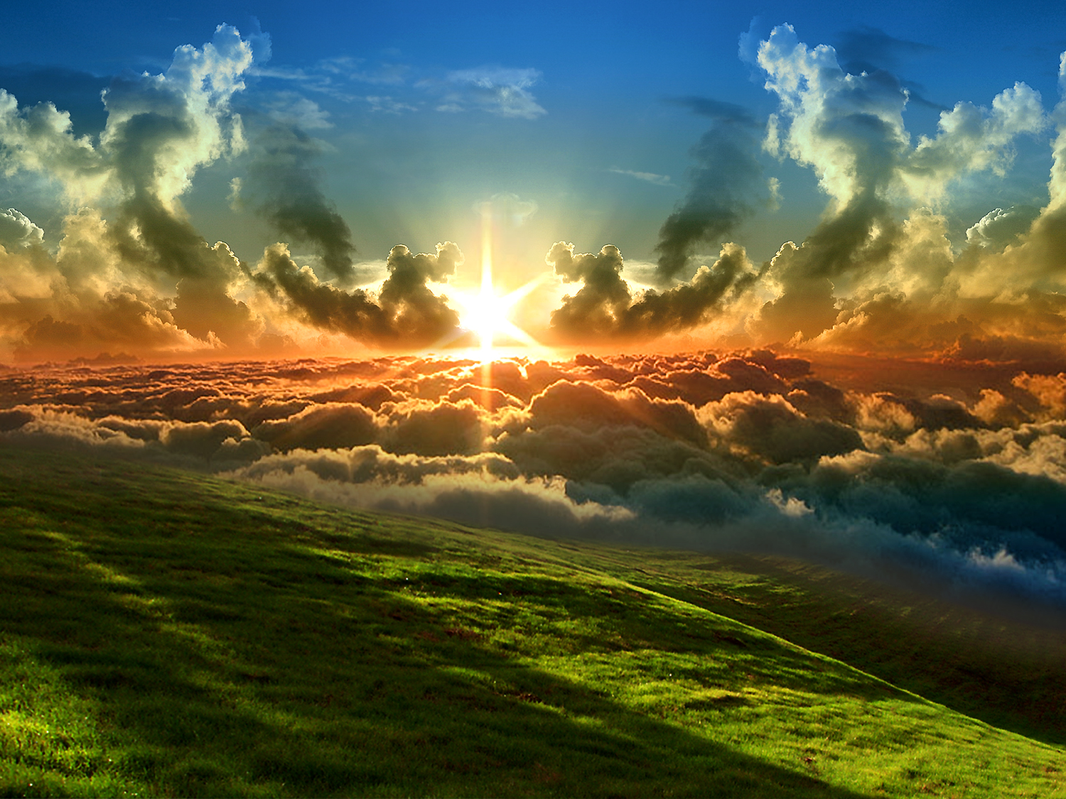
Assurance in 1 John 5:11-13
62 b) (2)
63
63
Should we
ever doubt?
Should we
ever doubt?
Should we
ever doubt?
"And this is what God has testified:
He has given us eternal life, and this life is in his Son. ¹²Whoever has the Son has life; whoever does not have God’s Son does not have life. ¹³I have written this to you who believe in the name of the Son of God, so that you may know you have eternal life."

Slide 71
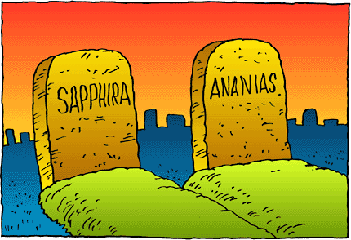
However, there is still divine discipline…

Slide 72
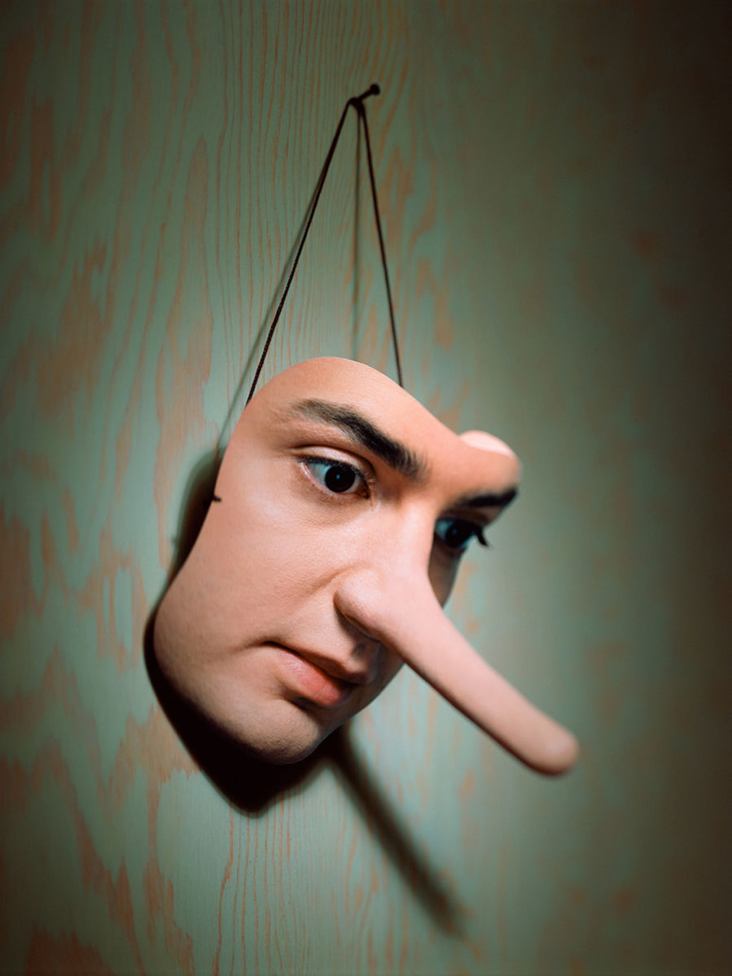
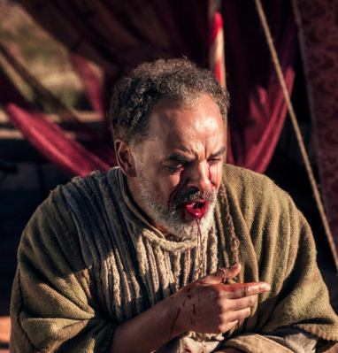
Ananias & Sapphira
Acts 5

Slide 73

Rewards can be lost!
"Watch out that you do not lose what we have worked so hard to achieve. Be diligent so that you receive your full reward" (2 John 8 NLT)
"I have given you an open door that no one can shut" (3:8)

Slide 74
How does God help us be secure?
Notes:
How does the LORD guide us towards this sense of well-being that we all need?

Slide 75
Main Idea of 2 Chronicles
God blesses and preserves us to worship him
Notes:
The LORD honors us when we honor him and keeps us to honor him even when we're unfaithful.

Slide 76
How does God help us be secure?
2 ways
Notes:
How does the LORD guide us towards this sense of well-being that we all need?

Slide 77
I. God blesses our worship.
2 Chronicles 1–9
Notes:
The LORD honors us when we honor him—and this gives us a sense of security.

Slide 78
II. God preserves us even in discipline.
2 Chronicles 10–36
Notes:
The LORD gives us security by keeping our salvation even when we’re unfaithful.

Slide 79
Be Secure
2 Chronicles
Dr. Rick Griffith • Crossroads International Church Singapore
CICFamily.com • BibleStudyDownloads.org

Slide 80
How can you be secure?
You can't.
This is God's work.
But has God secured you?

Slide 81
Ultimate Security
Solomon | Jesus
Son of David | Ultimate Son of David
Established united monarchy of Israel | Established kingdom of God upon earth
He built the temple | He was the temple
Established a kingdom that would last until 586 BC | Established a kingdom that will never end
Chastened because of his iniquity | Chastened because of our iniquities
The Kingdom Period Class #2 1st Chronicles 13-29
Published by Colin Bradley • http://slideplayer.com/slide/7850809/
Notes:
The Kingdom Period Class #2 1st Chronicles 13-29.
Published byColin Bradley
http://slideplayer.com/slide/7850809/

Slide 82
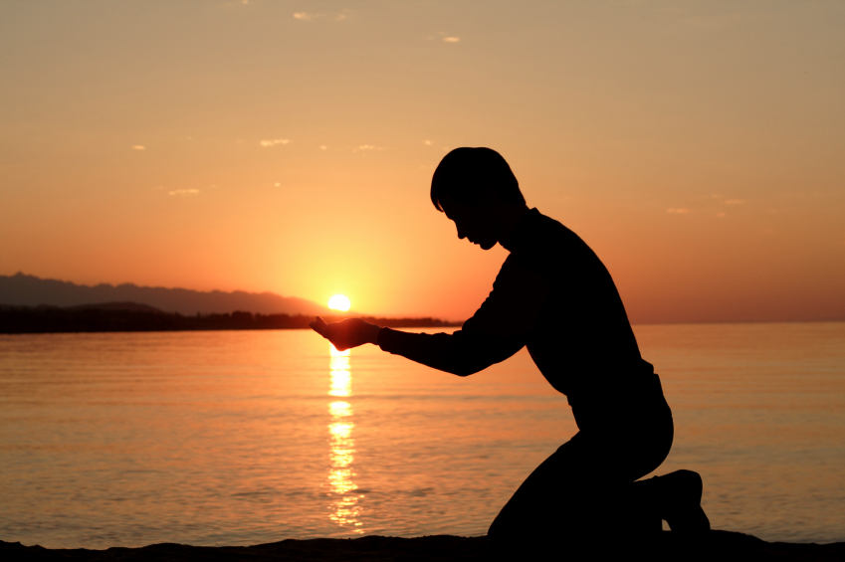
How can you better respond to his faithfulness in genuine worship?

Slide 83
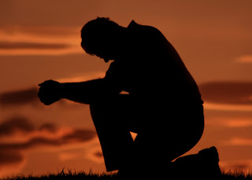
Take time out
Notes:
Will you take time out to ask the Lord about it? Take a day's fasting retreat!

Slide 84
Humility & Repentence
271
"Then if my people who are called by my name will humble themselves and pray and seek my face and turn from their wicked ways, I will hear from heaven and will forgive their sins and restore their land"
(2 Chronicles 7:14 NLT).

Slide 85
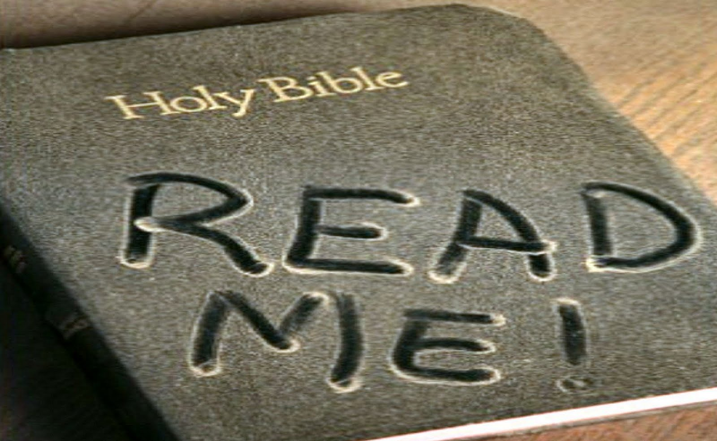
Need
Notes:
Some of us won't even commit to read one verse of the Bible each day but we SAY we want God's will!

Slide 86
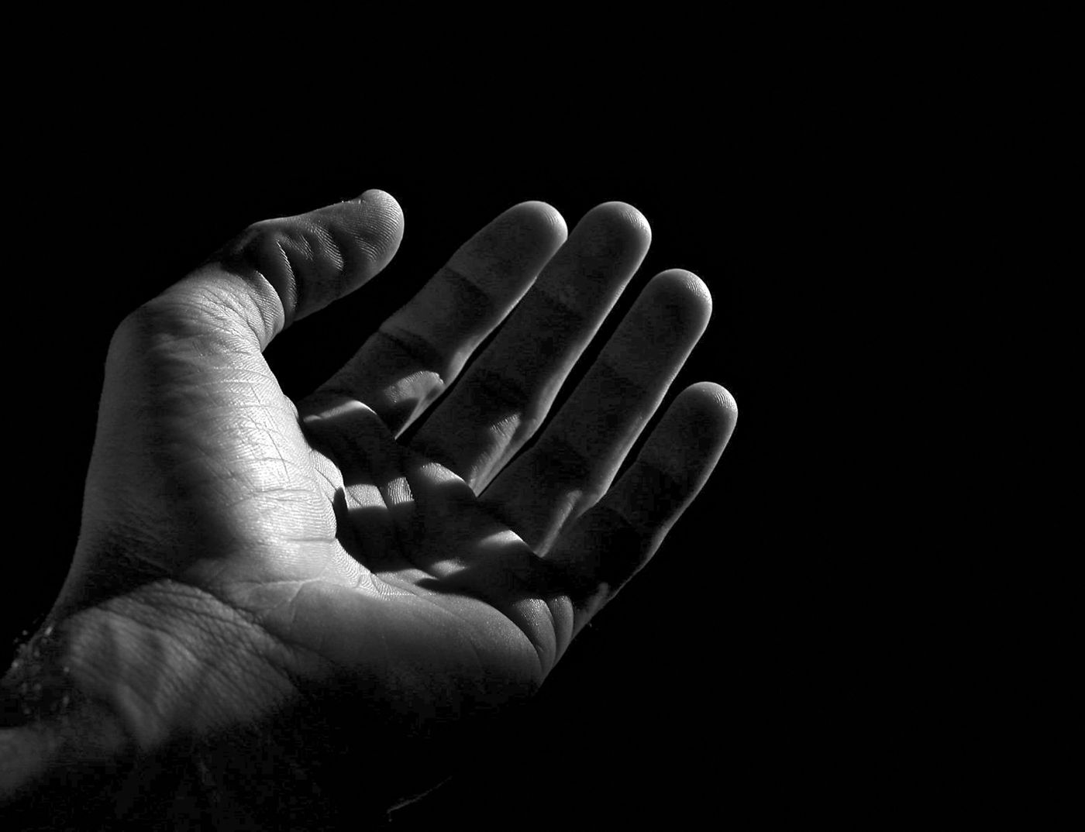
Open your hand
When your will is God's will,
you will have your will.
––Charles Spurgeon
Notes:
Here's the clincher though—like George Mueller, will you tell God right now that you'll do his will even before you know it? This makes complete sense, for, as Charles Spurgeon noted,
• "When your will is God's will, you will have your will."

Slide 87
Black

Slide 88


OT Preaching link at BibleStudyDownloads.org
Get this presentation and script for free!

